Slide 1


Hii,
Iam Siddhika
Welcome to Power BI Series
Part -67

Slide 2



I’m very excited to dive into this with you all!
Are you ready to enhance your data visualization skills?
We focus only on the most used and important Visuals
Today Content
VISUALIZING DATA
WATERFALL CHART
AI VISUALS
Q AND A

Slide 3
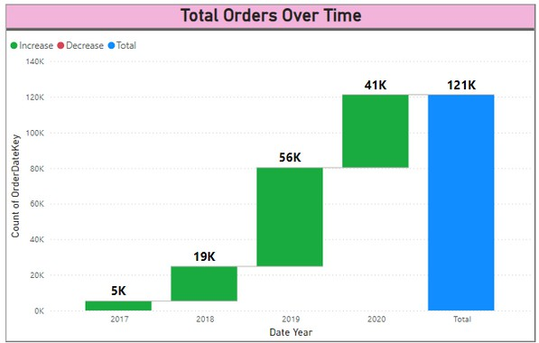


WATERFALL CHART
Just took for example.
A waterfall chart used to show how an initial value is increased and decreased by a series of intermediate values,
Go and
explore
formatting of
WATERFALL
chart
leading to a final value.
It demonstrates
effectively
the
cumulative sequentially
effect of introduced negative
positive or values.
When to Use:Incremental Analysis: To visualize how a starting value is affected by a series of intermediate changes leading to an end value.
Financial Analysis: To break down individual components of profit or loss over a period, showing the contribution of each component.
Project Management: To track progress, changes, or the impact of different phases on a project.
Performance Analysis: To understand the contributions of various factors to the overall performance.

Slide 4

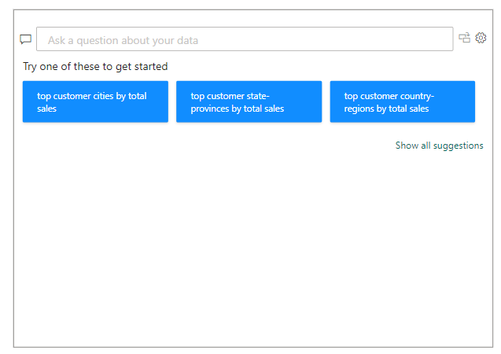

Q AND A
Go and explore
Sometimes the fastest way to get an answer from your data is to ask a question using natural language.
For example, "what is the total sales." Using Q&A, you can explore your data using intuitive, natural language capabilities and receive answers in the form of charts and graphs. Q&A is different from a search engine -- Q&A only provides results about the data in Power BI.

Slide 5


Thank you for joining me today to learn about Part -67 of Power BI!
Remember, Effective data visualization is crucial for turning data into meaningful insights and compelling narratives with Power BI.
Stay tuned for more insights and tips on Power BI in our next Series.
Follow
Siddhika Shah

